Slide 1


MGMT 59000:Big Data & MLOps
Final Project
Diabetes Prediction using Multi-Class Classification
BY:
NANDINI PRIYA DEVALLA
RUPALI KAKADIA

Slide 2
Problem Statement
Diabetes is a chronic disease affecting millions of individuals worldwide, leading to serious complications such as heart disease, kidney failure, and neuropathy. The goal of this project is to leverage big data and machine learning to predict diabetes risk based on health-related factors.
The model aims to offer early diabetes risk detection. It helps in proactive healthcare management. Insights from the model can support preventive measures. Early intervention is vital to mitigate diabetes impact. We leverage Spark ML and MLflow to solve this problem. Automation and experiment tracking are key.

Slide 3
Dataset Overview
Data Source
5
Feature Type
1
Public Health Datasets from Kaggle
Categorical, Integer
Number of Rows
6
Dataset Characteristics
2
253,680
Tabular, Multivariate
Number of Features
7
Subject Area
3
22
Health & Medicine
4
Target Variable
Diabetes_012 (0 = No, 1 = Pre-diabetes, 2 = Diabetes)

Slide 4
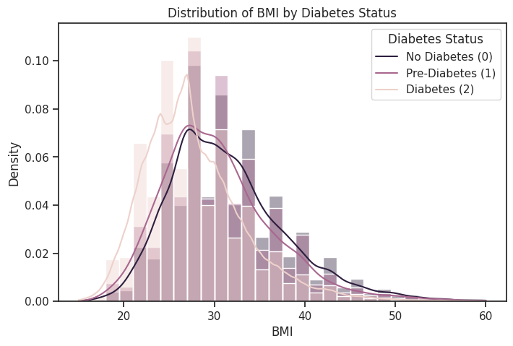



Exploratory Data Analysis (EDA)
Checked for missing values. Handling missing data ensured data integrity and model accuracy.
Outlier detection applied to BMI, PhysHlth, and MentHlth. Addressing outliers improved model robustness.
Addressed class imbalance via undersampling & oversampling. Balancing classes helped in fair prediction.

Slide 5
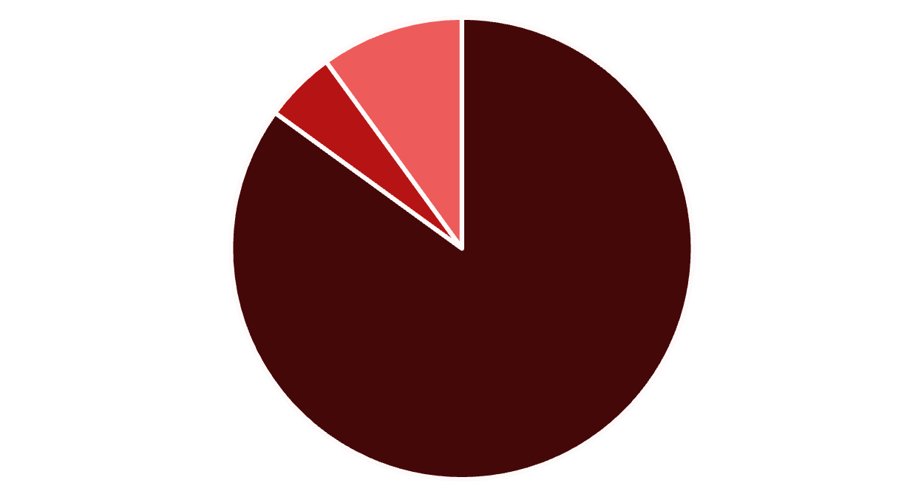
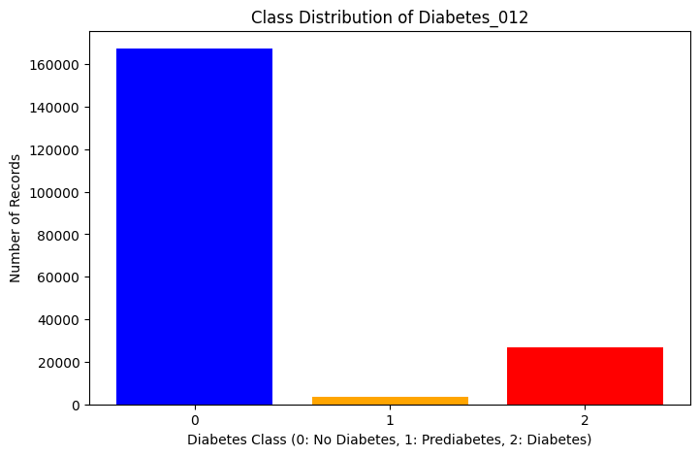
Class Distribution
Class distribution shows that there is a class imbalance
Class 0 (No Diabetes) has 85%.
Class 1 (Pre-diabetes) has 5%.
Class 2 (Diabetes) has 10%.
This imbalance was addressed during preprocessing.
No Diabetes
Pre-diabetes
Diabetes

Slide 6




Research Questions from Data
We conducted multiple exploratory data analysis queries to see how diabtetic classes are distributed across various age, education, BMI and gender levels. However, these were some of the main research questions we wanted to answer
What is the relationship between mental health issues and diabetes status?
Is there a relationship between smoking and diabetes?
How does the percentage of individuals who consume fruits daily vary across diabetes categories?
Does difficulty walking (DiffWalk) increase with diabetes?
Does income level impact diabetes prevalence?
!These research questions diagnose the impact and the symptoms of diabetes!

Slide 7
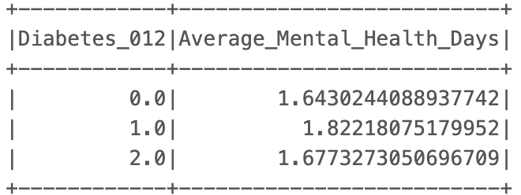
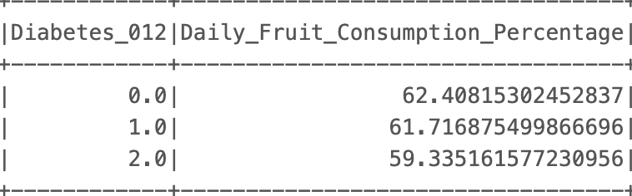
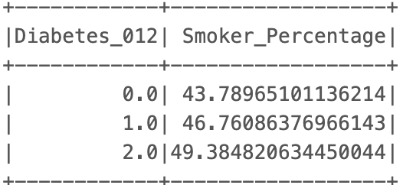
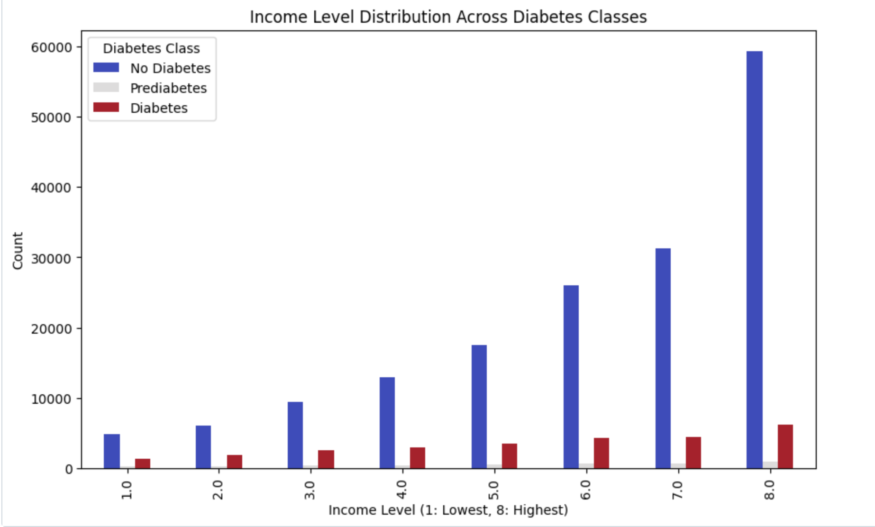
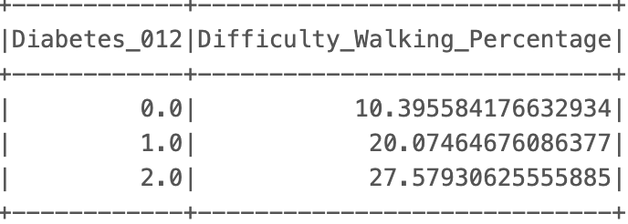
Research Answers from Data

Slide 8
Correlation Analysis
Key Features Identified
Pearson Correlation
HighBP
1
Hypertension significantly increases diabetes risk.
Used to identify strongest predictors.
BMI
Higher BMI correlates with higher diabetes prevalence.
2
Multicollinearity
Avoided multicollinearity in model training. Ensures model stability.
GenHlth
Self-rated general health impacts diabetes prediction.
3
Feature Selection
DiffWalk
Guides feature engineering and selection to enhances model efficiency.
Walking difficulty is a major risk indicator.

Slide 9
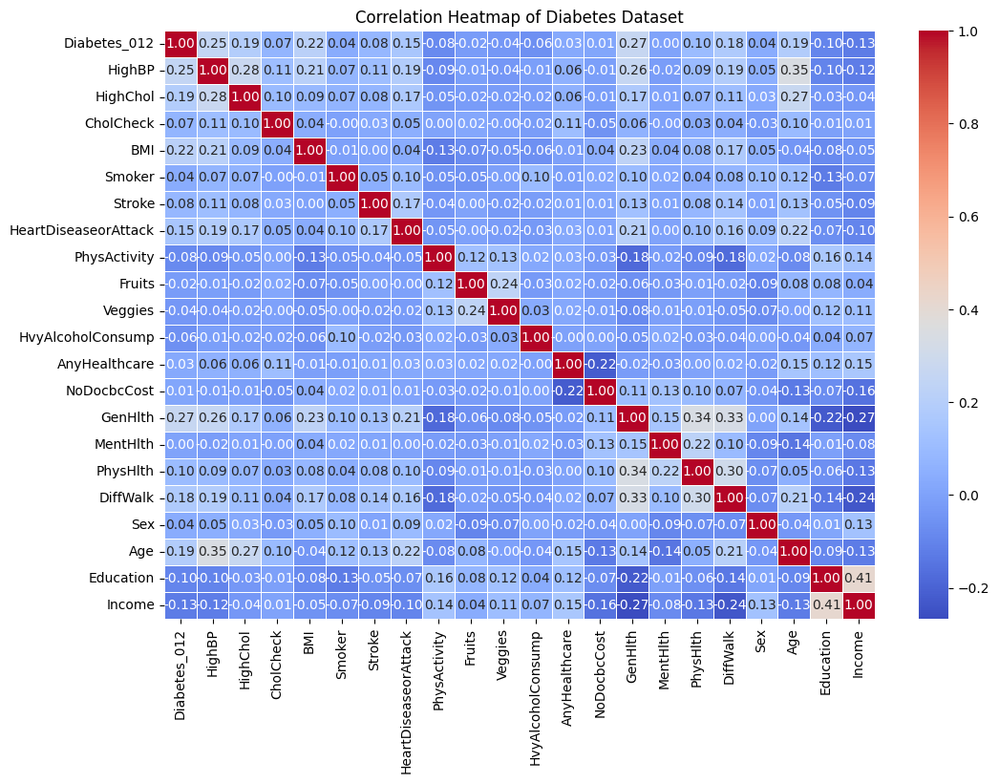

Slide 10
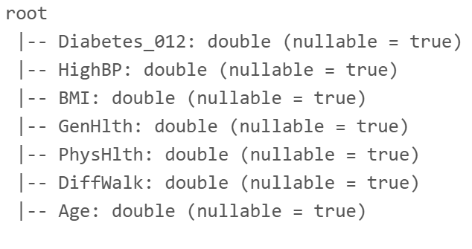


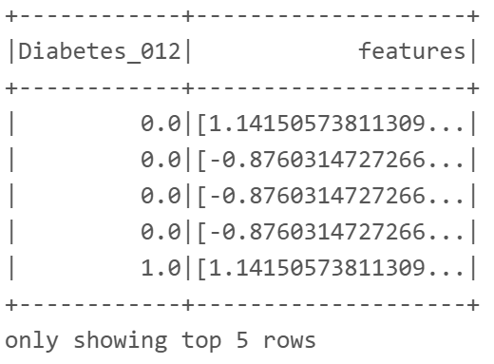
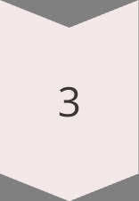
Feature Engineering & Selection
Key Features
Selected six key features: HighBP, BMI, GenHlth, PhysHlth, DiffWalk, Age. Reduced dimensionality.
VectorAssembler
Used VectorAssembler for MLlib. Prepares data for ML algorithms.
StandardScaler
Applied StandardScaler for GBT. Scales features for GBT model.

Slide 11



ML Pipeline - Data Preparation
Data Split
2
Data split into 80% training, 20% testing. Validates model performance.
Feature Vector
1
Features converted into a single vector. Simplifies processing.
Parquet Storage
3
Processed data stored as Parquet. Enhances data retrieval.

Slide 12
Model Training & Evaluation
1
Spark ML Pipelines
Logistic Regression, Decision Tree, RF & GBT
2
3
Metrics: accuracy, precision, recall and F1 score
Spark ML Pipelines used for training. Trained 4 different models. Evaluated accuracy, precision, recall, F1-score.Also, computed confusion matrix and miscalculation rate to get better insights.The models provide accurate and effective diabetes prediction.

Slide 13
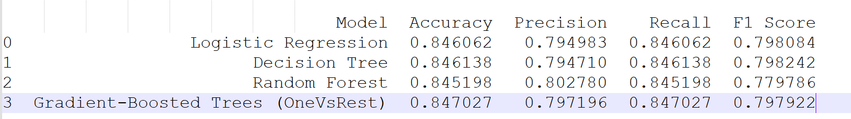
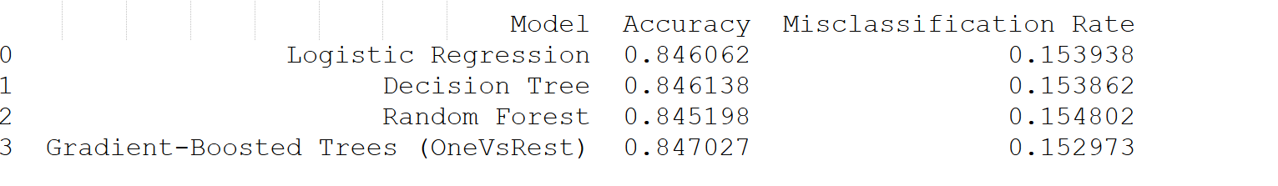
Gradient-Boosted Trees (OneVsRest) had the highest accuracy (0.8470) and the lowest misclassification rate (0.1529), making it the best-performing model.
Random Forest showed the highest precision (0.8028), making it a strong alternative.
All models performed similarly, but GBT had the best balance between accuracy and misclassification rate.
Based on these results, GBT and RF were selected for further tuning and automation.

Slide 14
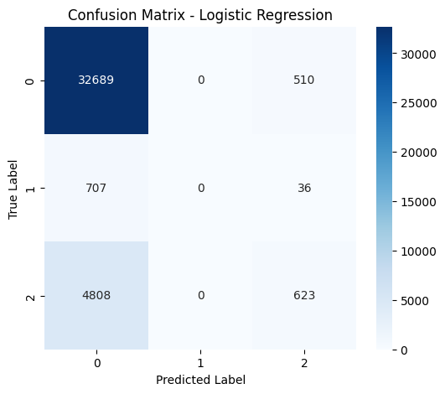


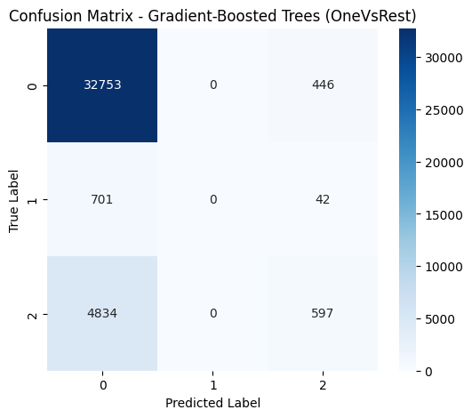

Slide 15
Hyperparameter Tuning & Automation
Used Cross Validation to find the best hyperparameters.
Random Forest: Tuned numTrees (10, 20) & maxDepth (3, 5).
GBT: Tuned maxIter (5, 10).
Logged all experiments using MLflow.
MLflow automatically tracked model parameters, metrics & saved best models.
Model Performance (Final Results):
Random Forest (Tuned): 84.52%
Gradient-Boosted Trees (OneVsRest): 84.70%
Insights:
GBT had the best performance after hyperparameter tuning.
Automation via MLflow ensured reproducibility and tracking of model metrics.
Class imbalance handling was critical to improve predictions.

Slide 16
Conclusion & Business Insights
Key Risk Factors Identified:
High Blood Pressure, BMI, Physical Health, and Difficulty Walking emerged as the strongest predictors of diabetes.
Older age groups (50-59) show the highest prevalence of severe diabetes cases.
Gender & Lifestyle Impact:
Males had a slightly higher prevalence of severe diabetes.
Poor general health and physical inactivity strongly correlate with diabetes.
Mental health and stress may also play a role in diabetes progression.
Business Recommendations:
Early screening programs should focus on middle-aged individuals with high-risk factors.
Encourage lifestyle interventions (physical activity & diet control) for at-risk individuals.
Future work could include more advanced feature engineering, deep learning models, or real-time predictions in a healthcare system.

Slide 17
Challenges Faced
Class Imbalance:
Severe diabetes cases were significantly fewer, making it harder for models to learn minority class patterns.
Tried both undersampling and oversampling, but computational cost was a concern.
Computational Constraints:
Hyperparameter tuning was slow, requiring optimized grid search.
Running multiple models took significant processing time, forcing selective tuning.
Future Improvements
Enhanced Feature Engineering – Exploring interaction terms (e.g., Age × BMI) and advanced encoding techniques to better capture hidden patterns.
Exploring More Complex Models – Testing XGBoost, LightGBM, or Neural Networks to improve accuracy and efficiency.
Optimizing Dimensionality Reduction – Fine-tuning PCA to retain maximum information while improving computational efficiency.

Slide 18
THANK YOU!

